Slide 1
Angular 2

Slide 2
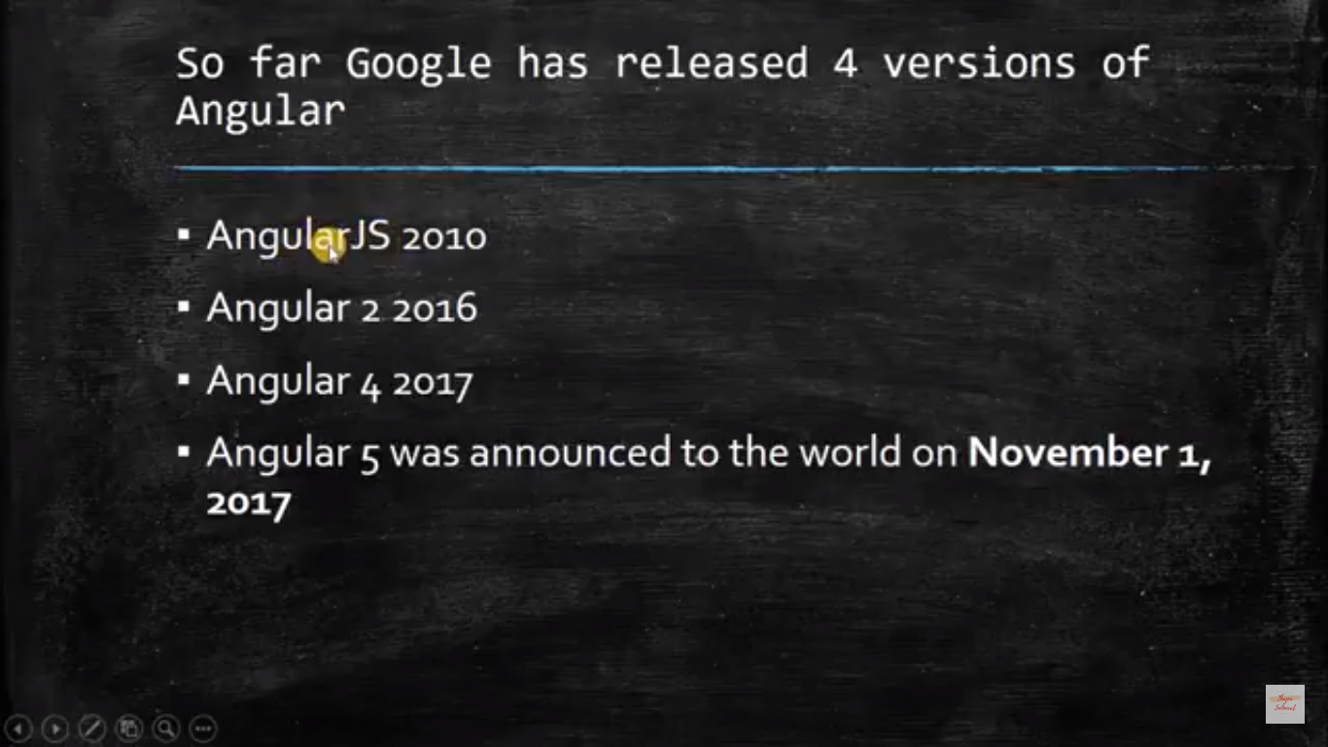
Versions

Slide 3
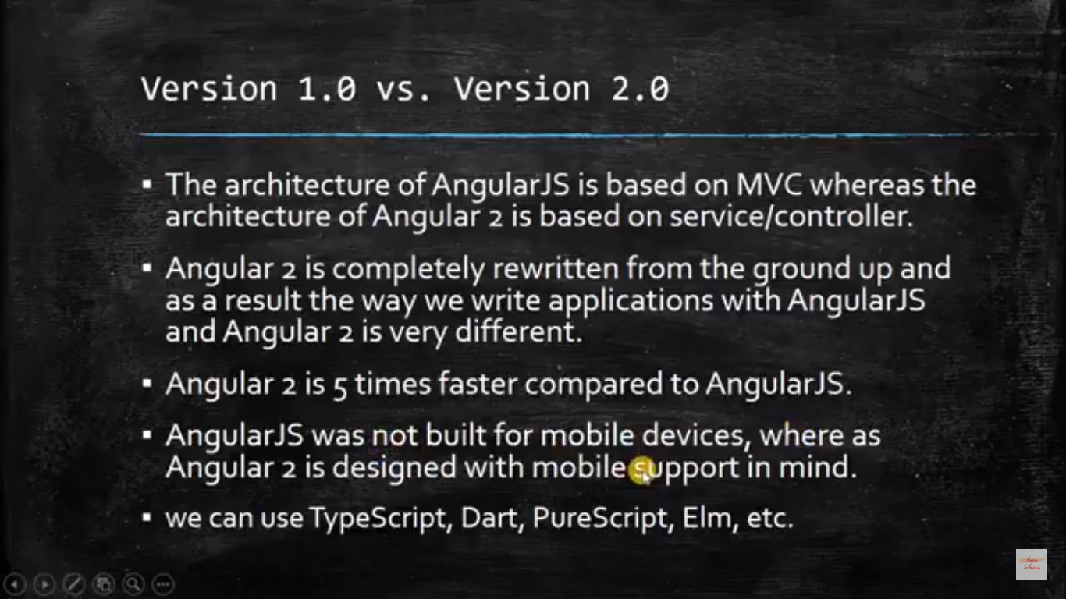

Slide 4
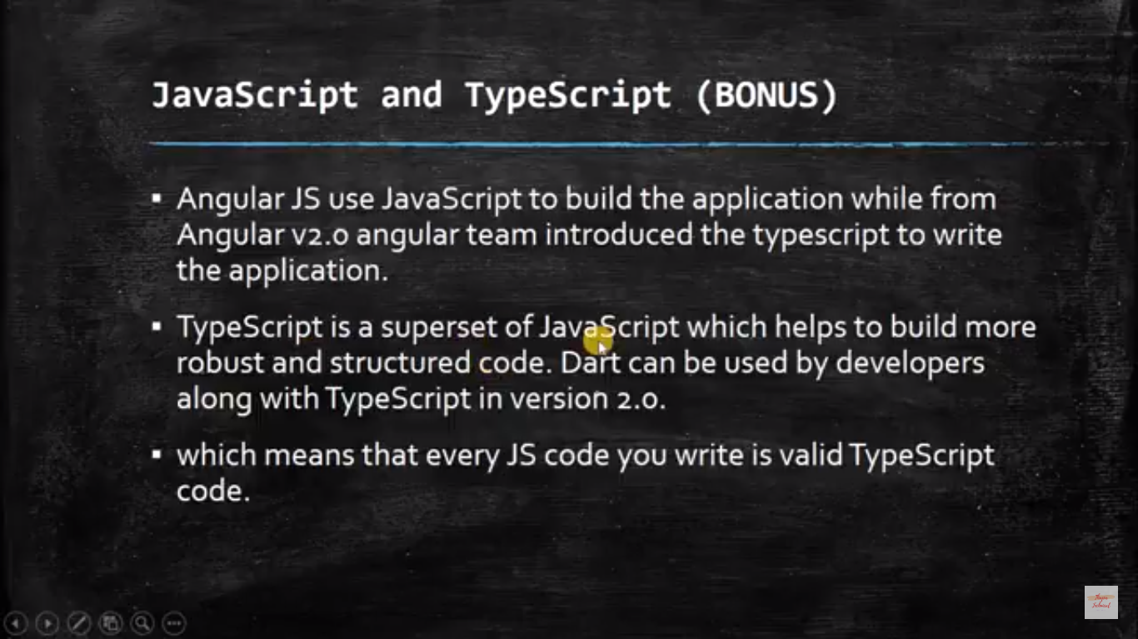

Slide 5
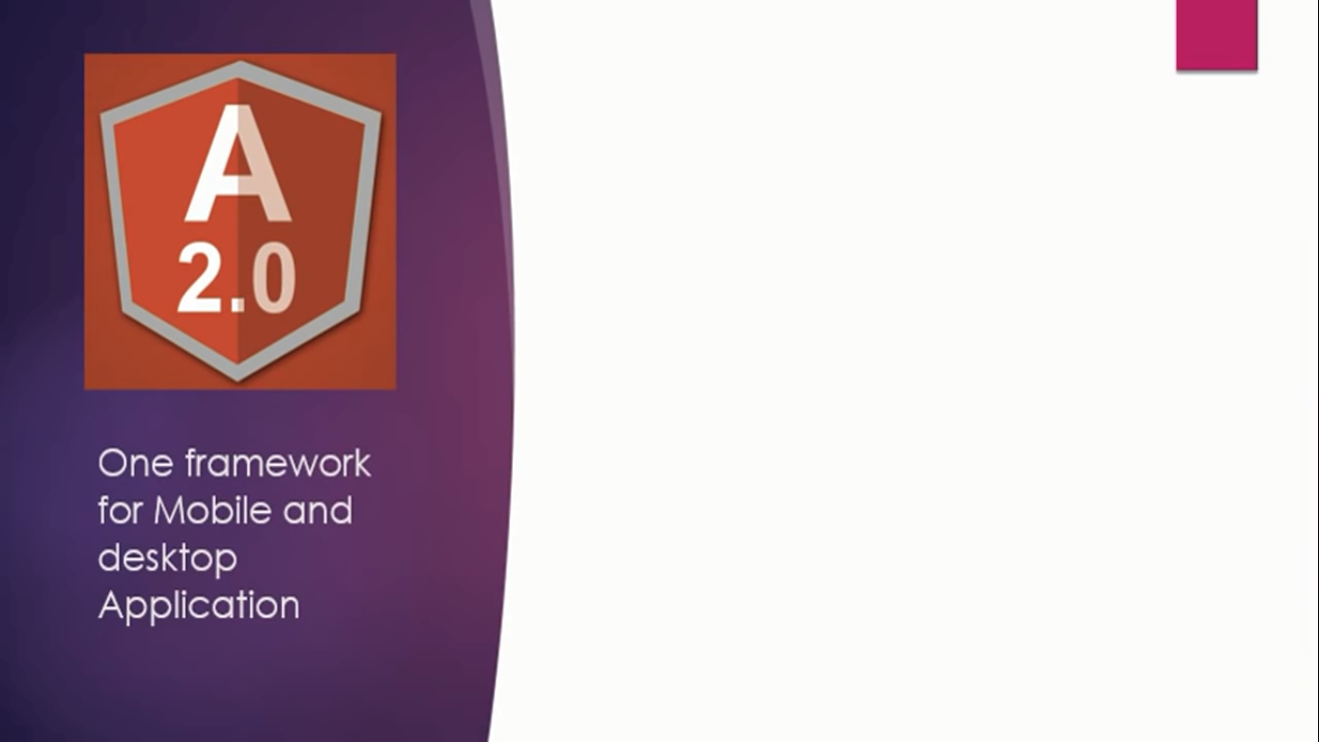
Introduction Angular 2

Slide 6
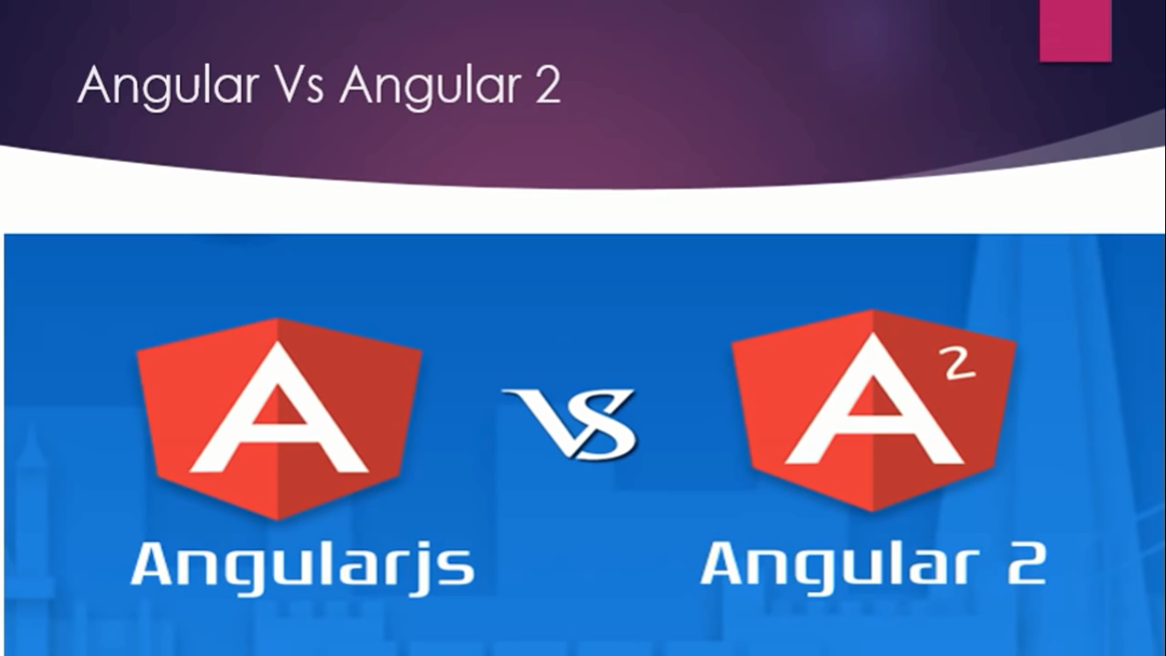
SPA(Single page Application)MVC

Slide 7
1. SPA
2.MVC

Slide 8
Angular 2
1.Type script and java ES6 ko mila kar bana h
2. java script is a subset of typescript
Components
Data binding
Routing
MVW (Model view whatever)

Slide 9

History

Slide 10
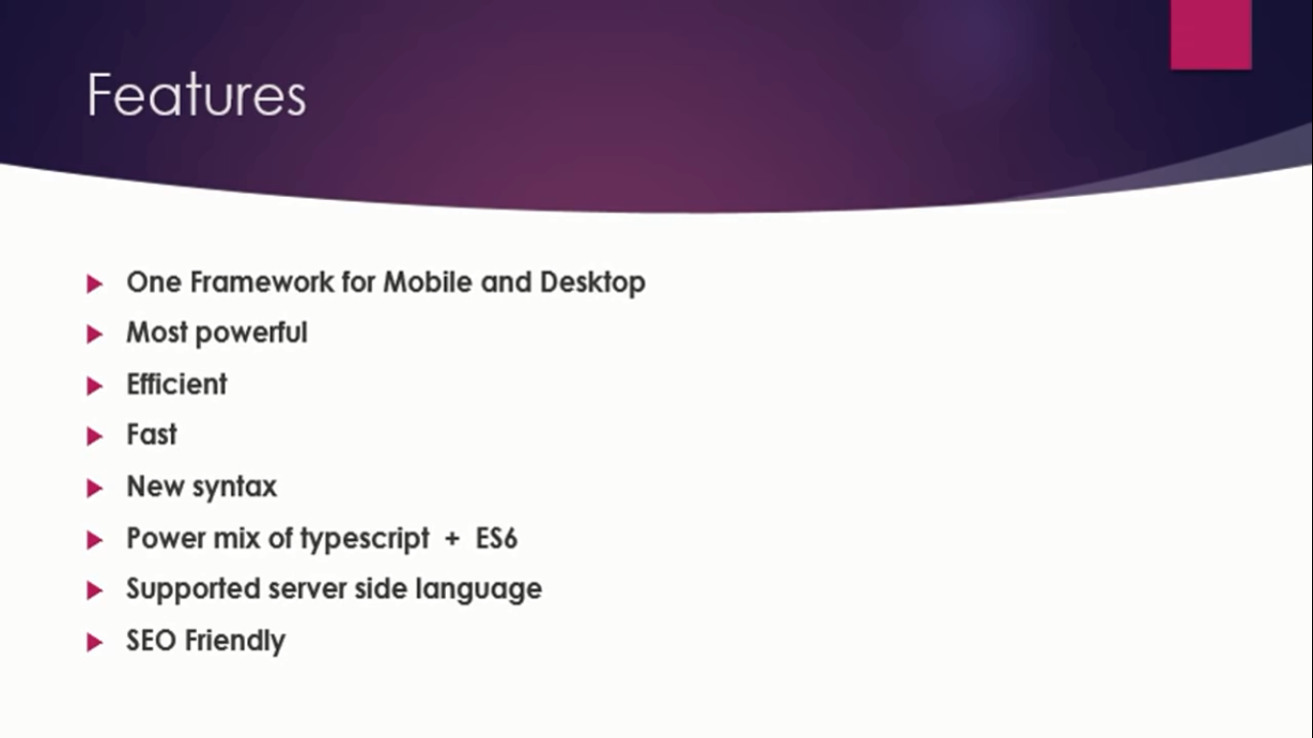
Features

Slide 11
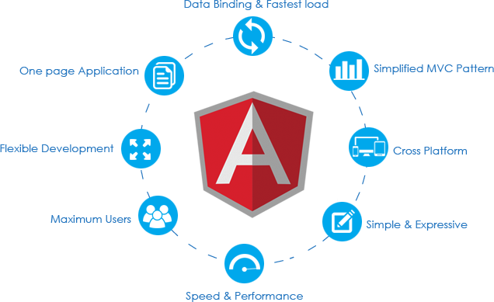

Slide 12
